Slide 1
ADARSH INSTITUTE OF TECHNOLOGY AND RESEARCH CENTRE, VITA
B Tech in Mechanical Engineering
Project Phase – II
“Design and Development of Automatic Surface Defect Detection in Hot rolled Steel Strip By Python”
By
Miss.Chandanshive Pallavi Shashikant
Miss.Chavan Aarti Haribhau
Miss.Kale Pushpa Dnyaneshwar
Miss.Sutar Pradnya Dilip
Under the Guidance of
Asst. Prof.Mr.U.Y.Siddha
DEPARTMENT OF MECHANICAL ENGINEERING
YEAR 2020-21

Slide 2
Contents
Introduction
Literature Review
Problem Statement
Objectives
Methodology
Project Plan (Process Chart)
References

Slide 3
Introduction
•Hot rolled steel strip has an essential role in many industrial fields.
•Automatic work .
•Industry 4.0
•Real-time accurate inspection of surface defect.
•High accuracy rate and reliability.
•Improve defect recognition rate with extraction and defect classification.

Slide 4
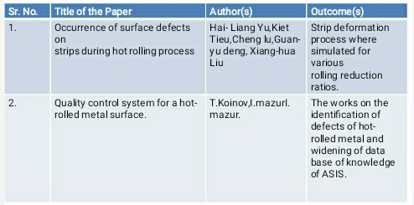
Literature Review

Slide 5
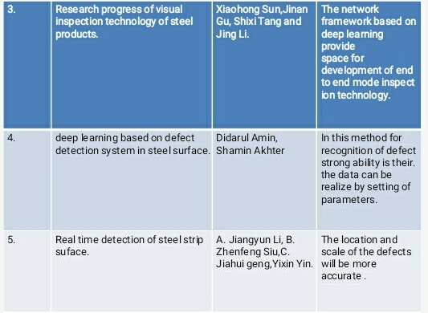

Slide 6
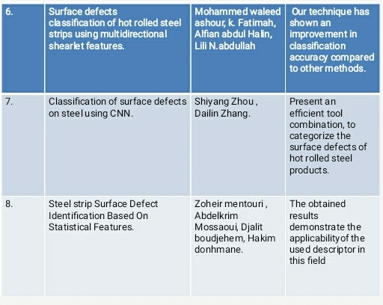

Slide 7
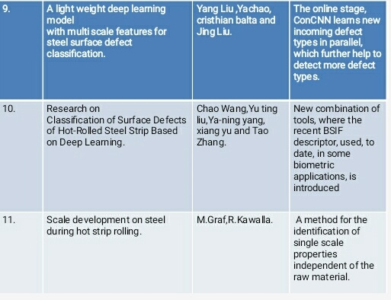

Slide 8
Problem Statement
Surface defect is one of the important factors affecting the quality of hot rolled steel strip.
Replaced the traditional method of manual detection, and has been applied in large-scale production practice.
Having low accuracy factor there is need to be for enhancing the accuracy percentage.
Replacing the Automatic Programming to genetic Programmimng.

Slide 9
Objectives
To detect surface quality of steel.
To evaluate the models, accuracy metrics used.
To detect and classify steel surface defects using machine and deep learning.
To give better accuracy.
To improve algorithm by localizating and classifying surface defects on sheet metal.
To find out the surface defects of the hot-rolled round steel under help of software.

Slide 10
Methodology
Study of literature
DataPreprocessing
Setup and Data Importing
Project Identification
Build a Algorithm
Training and Testing

Slide 11
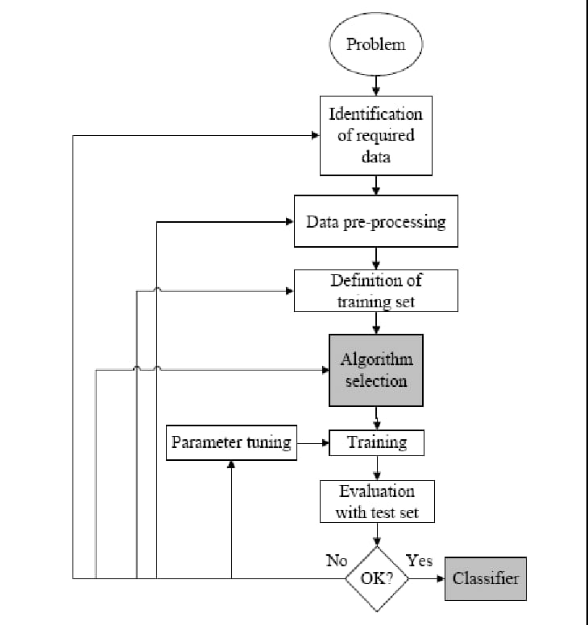
Project layout

Slide 12
About Dataset
In the Northeastern University (NEU) surface defect database, six kinds of typical surface defects of the hot-rolled steel strip are collected, i.e., rolled-in scale (RS), patches (Pa), crazing (Cr), pitted surface (PS), inclusion (In) and scratches (Sc). The database includes 1,800 grayscale images
It is verified and standard dataset . this dataset is approved by the manufacturing global-digital manufacturing platform and Smart Manufacturing Community-Mesa international.

Slide 13
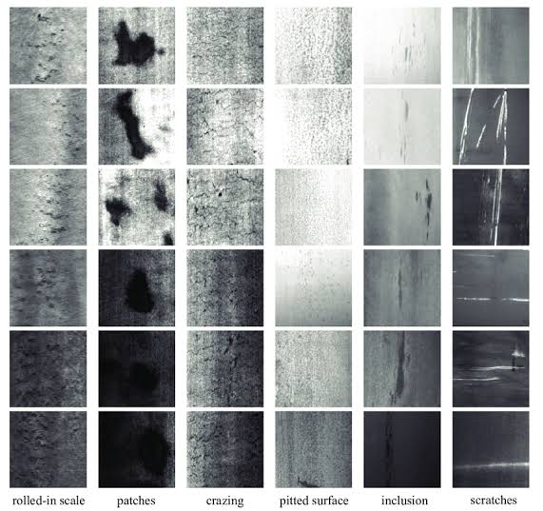

Slide 14
Importing data
OS
Numpy
Pandas
Tensorflow
Matplotlab
Keras

Slide 15
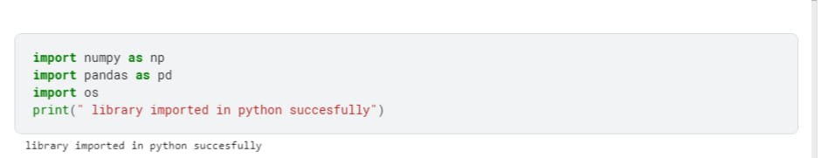
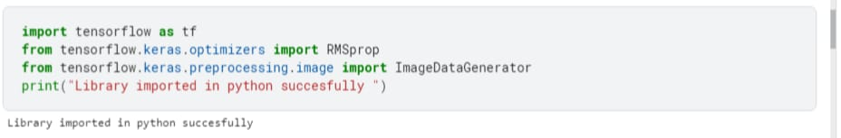

Slide 16
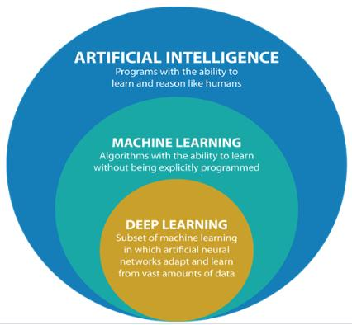

Slide 17
Machine learning
It is the study of computer algorithms that improve automatically through experience and by the use of data.It focuses on the development of computer programs that can access data and use it to learn for themselves.

Slide 18
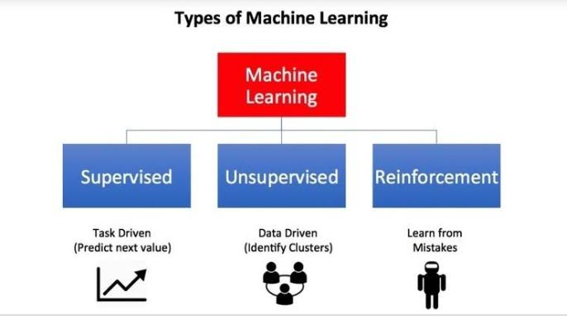

Slide 19

Deep learning
It is an artificial intelligence function that imitates the workings of the human brain in processing data and creating patterns for use in decision making.

Slide 20
Convolutional Neural Network
CNN is a class of deep neural networks, most commonly applied to analyze visual imagery. It uses a special technique called Convolution.It is uses for image classification and recognition because of its high accuracy.

Slide 21
Design and Analysis
Selection-
1.Machine learning->Categorical data type->supervised learning->classification algorithm
2.Deep learning-> CNN neural networkDesign calculations
3.Size of Dataset-1800 images classified into 6 defect into 300 images

Slide 22
4. Rescaling all Images using ImageDataGenerator library rescale=1. / 255, shear_range=0.2, zoom_range=0.2, horizontal_flip=True
5.Training data set used-80% I.e=1656 imagesTesting Data set used-10%=72Validation data set used-10%=72
6.Activation function-reluOptimizer-'rmspropEpoch-20Batch size-32(By default)

Slide 23
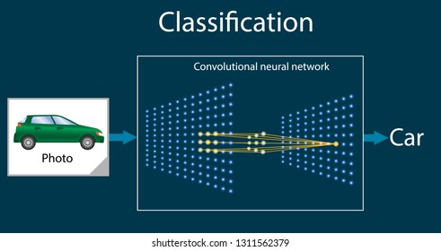

Slide 24
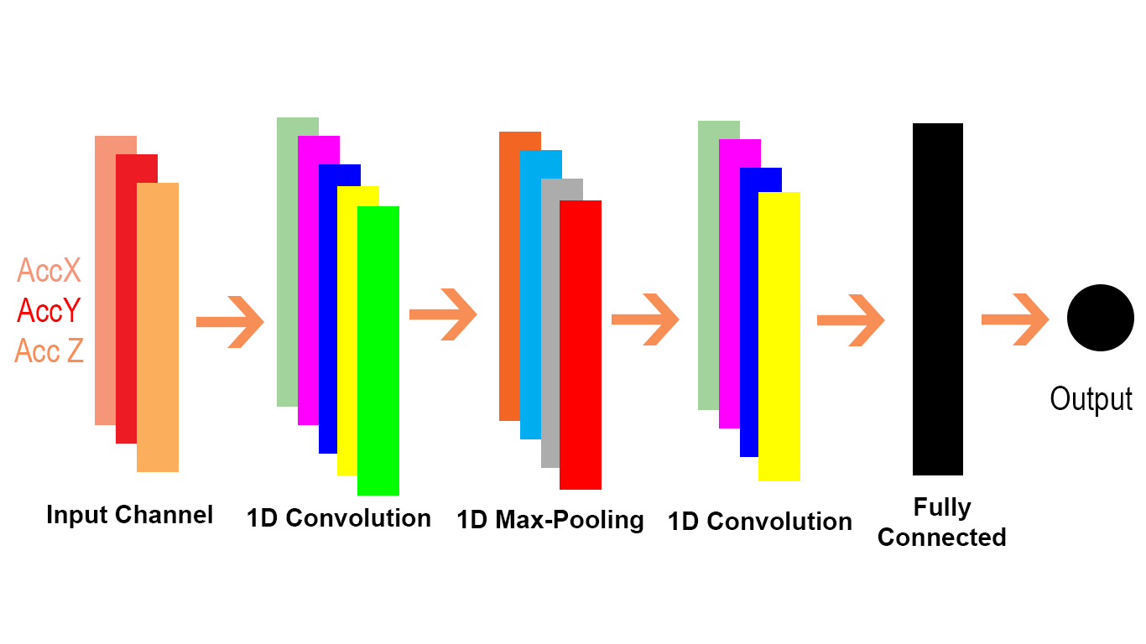

Slide 25
Training and testing the model:
The number of epochs is the number of times the model will cycle through the data. The more epochs we run, the more the model will improve, up to a certain point. After that point, the model will stop improving during each epoch.

Slide 26
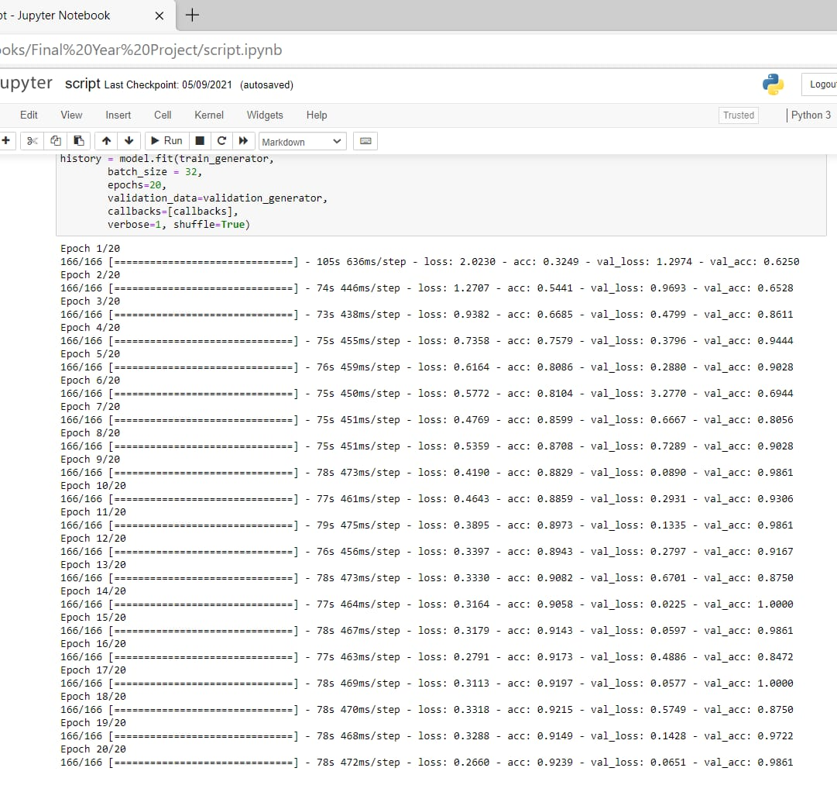

Slide 27
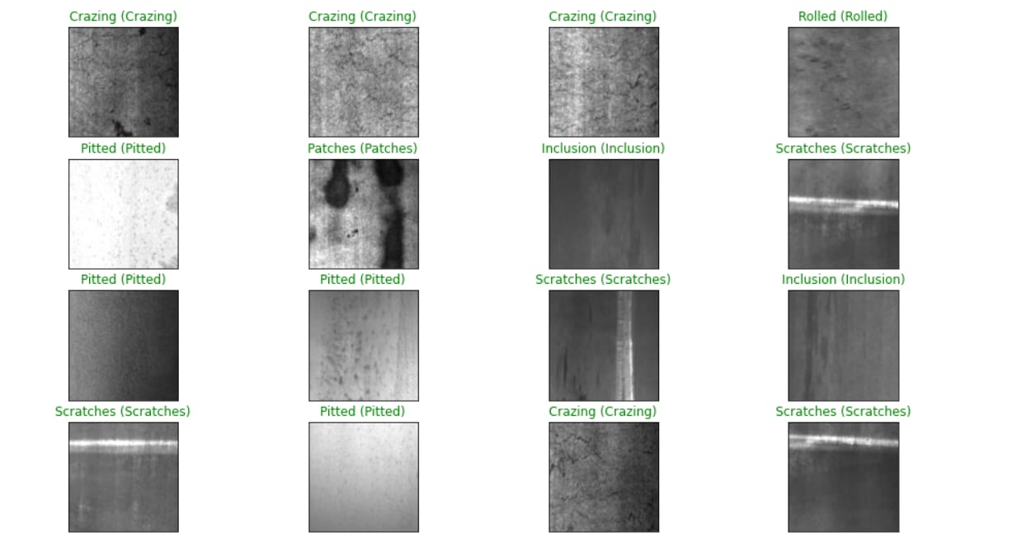

Slide 28
References
[1] Hai- Liang Yu,Kiet Tieu,Cheng lu,Guan-yu deng, Xiang-hua Liu, “ Occurrence of surface defects on strips during hot rolling process” .Receivd 13 july 2012/Accepted :3 october 2012
[2] T.Koinov (University of chemical yechnology and metallurgy,Sofia, Bulgaria),I.mazur (Lipestsk state technical university, Russia), “Quality control system for a hot-rolled metal surface”. 2016.
[3]Xiaohong Sun,Jinan Gu, Shixi Tang and Jing Li, Research progress of visual inspection technology of steel products”.received:15 september 2018, Accepted: 2 november 2018, Published : 8November 2018.

Slide 29
[4]Didarul Amin,Shamin Akhter (University of business agriculture and technology Dhaka, Bangladesh), “deep learning based on defect detection system in steel surface”,didardul38@gmail.com,7 june 2020.
[5] A. Jiangyun Li, B. Zhenfeng Siu,C. Jiahui geng,Yixin Yin, Real time detection of steel strip surface”.2018,IFAC(International Federattion of automatic control)hosting by Elesevier ltd. All right reserved.
[6] Mohammed waleed ashour, k. Fatimah,Alfian abdul Halin,Lili N.abdullah, “Surface defects classification of hot rolled steel strips using multidirectional shearlet features” . Arabian Journal for Science and Engineering ,Received :1 August 2017;Accepted :17 May 2018
[7]Shiyang Zhou ,Dailin Zhang( Huazhong university of science and technology), ,"Classification “Classification of surface defects on steel using CNN “. Wuhan,430074.Received :2015-11-30;accepted for publication :2016-01-07

Slide 30
[8]Zoheir mentouri ,Abdelkrim Mossaoui, Djalit boudjehem, Hakim donhmane,"Steel Strip Surface Defect Identification Based On Statistical Features",U.P.B.Sci.Bull.,Series B,Vol.80,Iss.4,2018
[9] Yang Liu ,Yachao,cristhian balta and Jing Liu."A Light-Weight Deep-learning Model with Multi-Scale Features for Steel surface Defect Classification ",Bremen Institute for Mechanical Engineering -bime,University of Bremen ,28359 Bremen,Germany;Institute of Computer Science ,University of Goettingen ,37077 Goettingen ,Germany.Received :7 sept 2020; Accepted:13 oct 2020;Published :16 oct 2020.
[10] Chao Wang,Yu ting liu,Ya-ning yang,xiang yu and Tao Zhang."Research on Classification of Surface Defects of Hot-Rolled Steel Strip Based on Deep Learning". College of Electromechanical Engineering ,Dalian Liaoning 116605,China. Control and Automation (ICA 2019).
[11]M.Graf,R.Kawalla,"Scale development on steel during hot strip rolling",La Metallurgia Italiana-n.2/2014

Slide 31
Thank You

